Slide 1
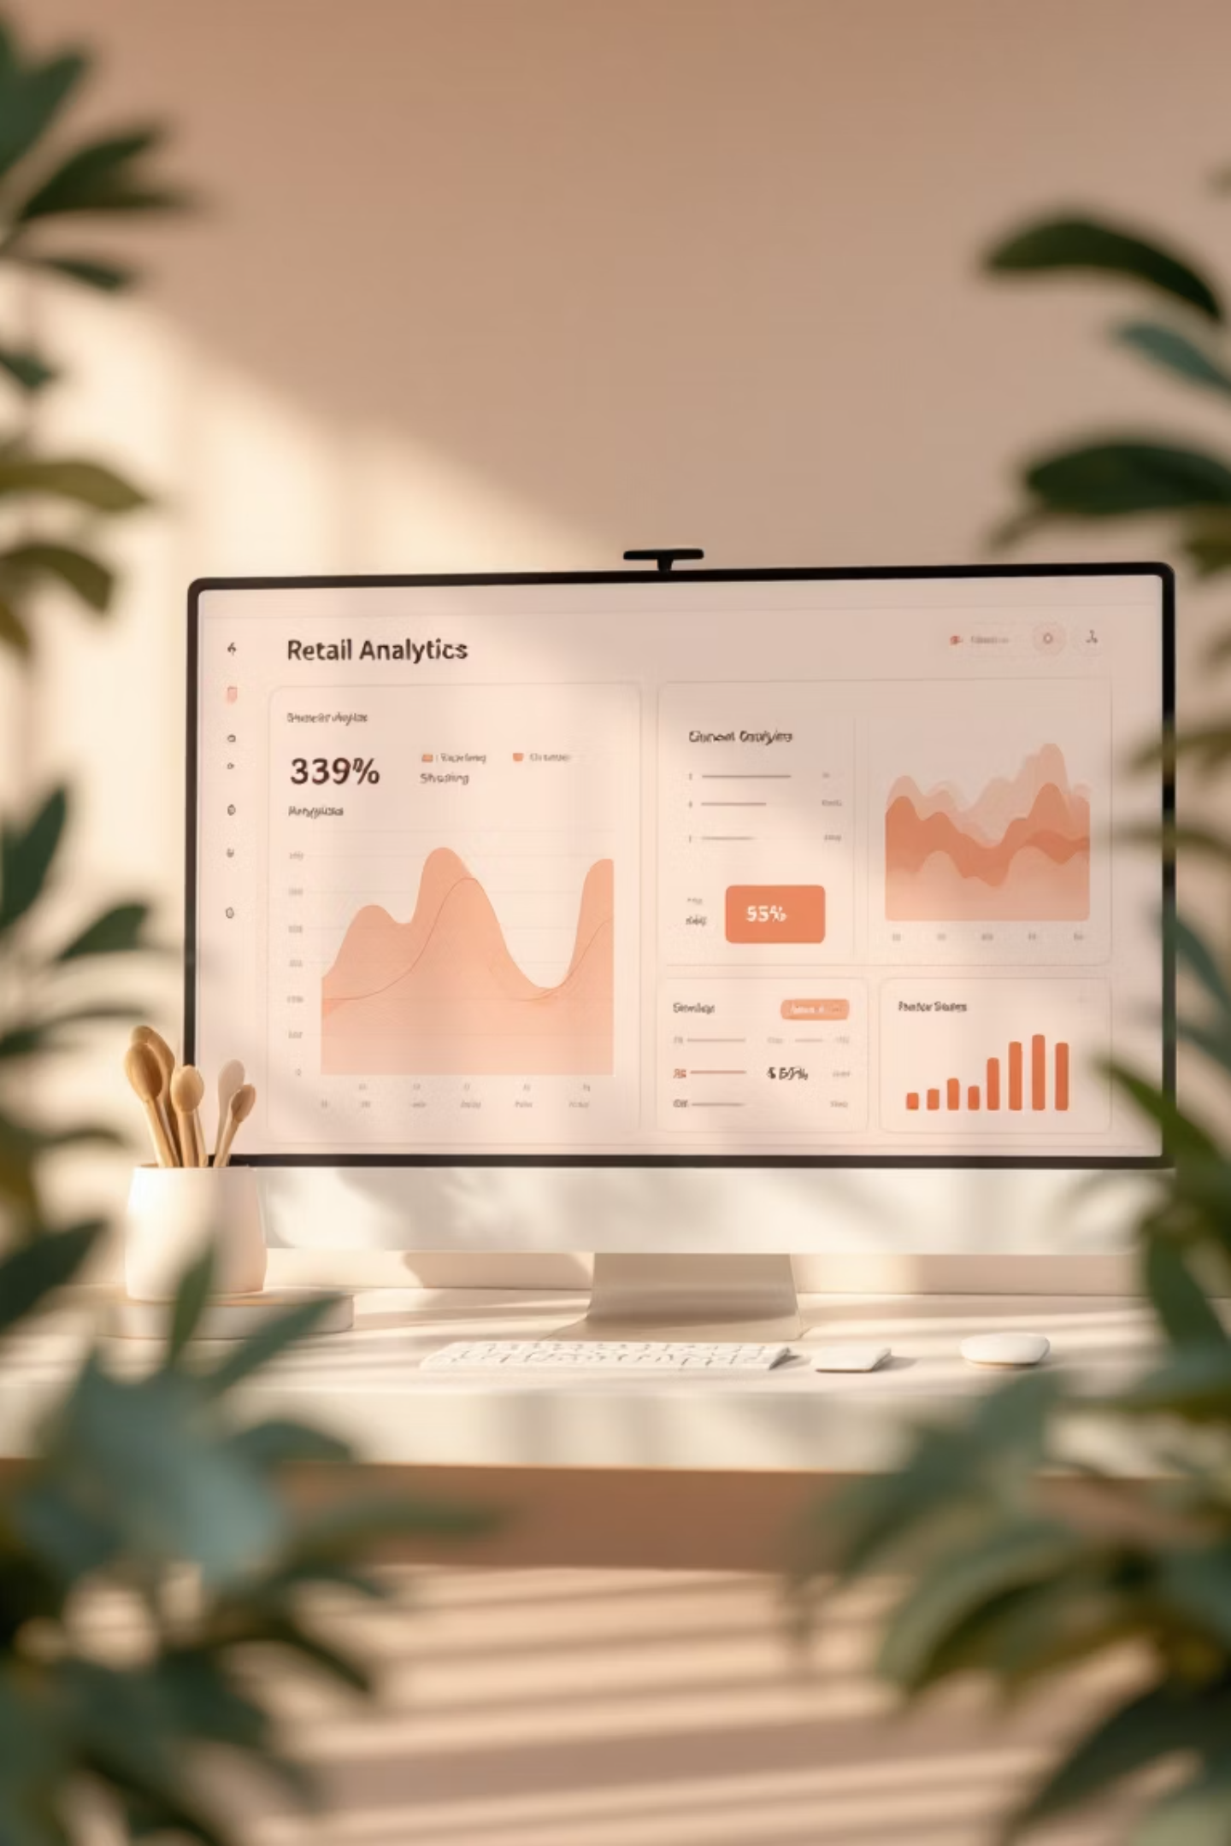
Customer Shopping Behavior Analysis
Uncovering insights from 3,900 purchases to guide strategic business decisions

Slide 2

Dataset Overview
3,900
18
37
Total Purchases
Data Points
Missing Values
Transactions analyzed
Features per transaction
In review ratings only
Key features include customer demographics, purchase details, and shopping behavior patterns across multiple product categories.

Slide 3
Data Preparation Process
01
02
Data Loading & Exploration
Missing Data Handling
Imported dataset using pandas, checked structure with df.info() and summary statistics
Imputed Review Rating nulls using median rating per product category
03
04
Feature Engineering
Database Integration
Created age_group and purchase_frequency_days columns for deeper analysis
Connected to PostgreSQL and loaded cleaned data for SQL analysis

Slide 4
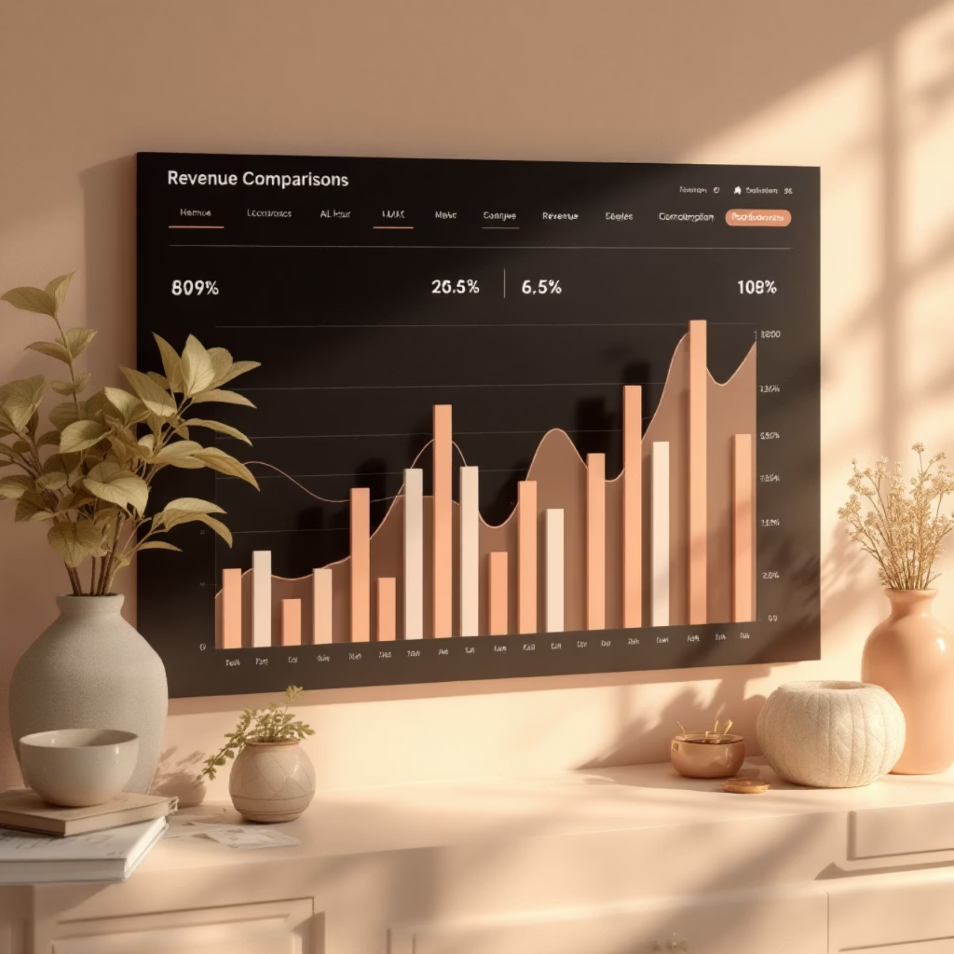

Revenue Insights
Gender Comparison
Age Group Revenue
Male and female customers show distinct spending patterns across categories
Different age segments contribute varying revenue levels

Slide 5


Discount & Spending Behavior
High-Spending Discount Users
Customers using discounts while spending above average purchase amount
Discount-Dependent Products
Top 5 products with highest percentage of discounted purchases identified
Balance promotional strategies with margin control to optimize profitability

Slide 6

Product Performance
1
2
3
Top-Rated Products
Category Leaders
Customer Favorites
Identified 5 products with highest average review ratings
Top 3 most purchased products within each category
Products consistently driving repeat purchases

Slide 7
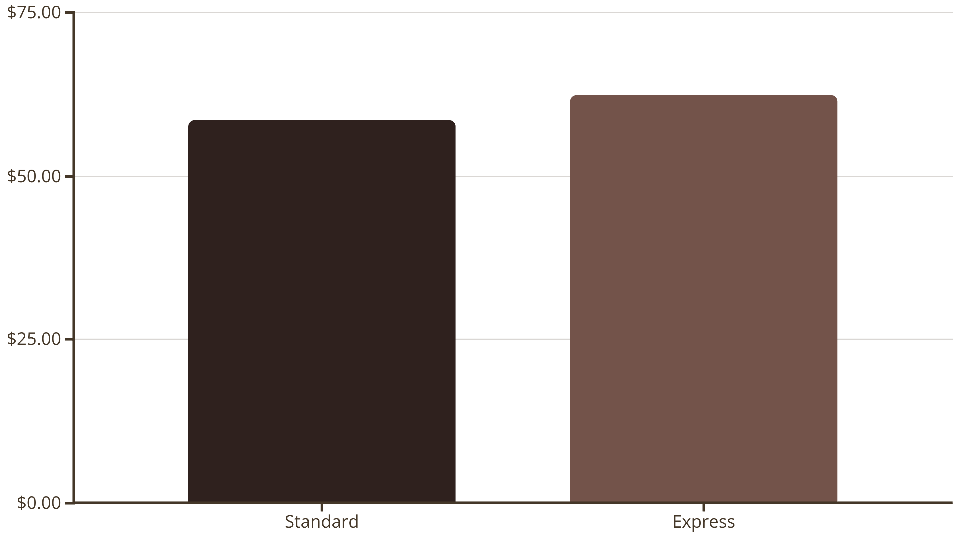
Shipping & Purchase Patterns
Express shipping users demonstrate higher average purchase amounts, indicating premium customer segment

Slide 8



Customer Segmentation
1
Loyal
2
Returning
3
New
Customers classified based on purchase history and frequency patterns
Repeat buyers with 5+ purchases show higher subscription rates
Loyal segment drives significant revenue contribution

Slide 9
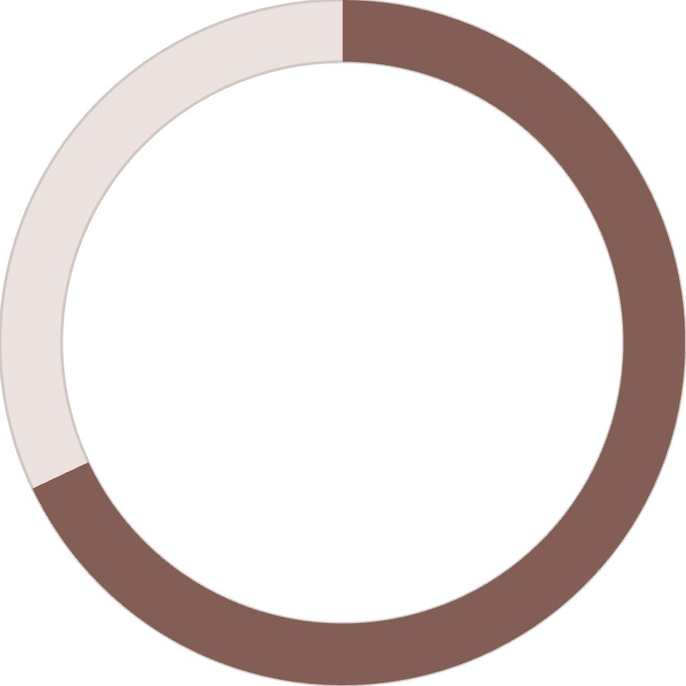
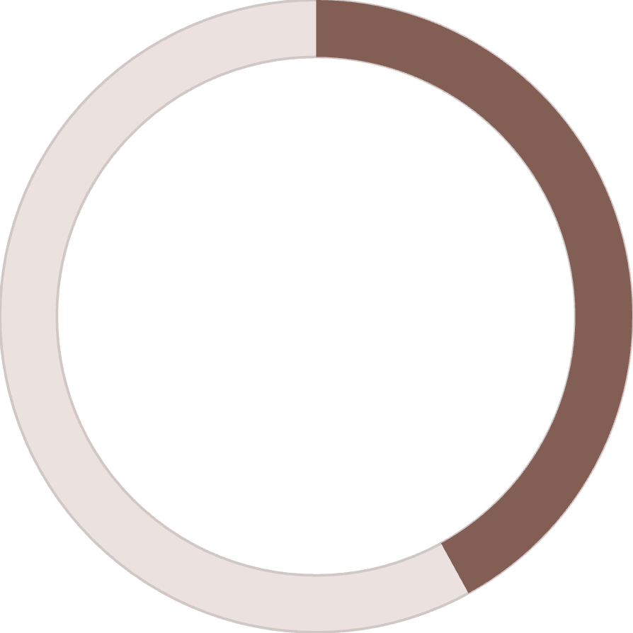
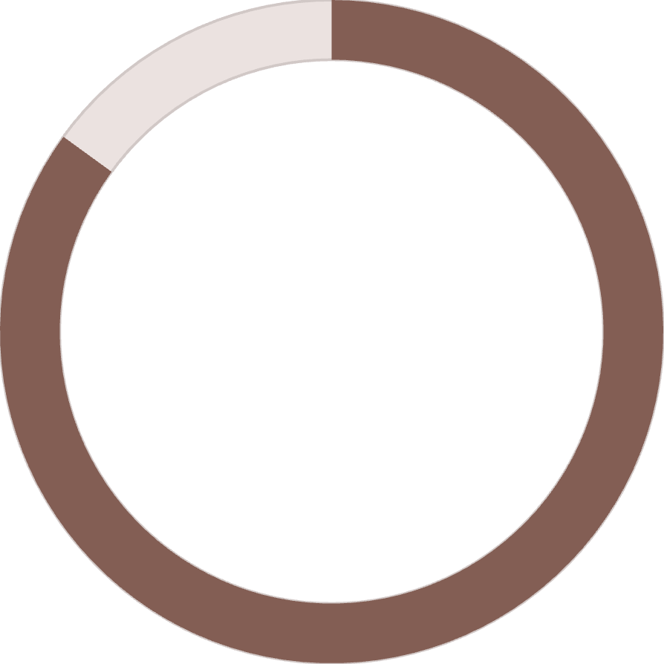
Subscription Analysis
68%
42%
85%
Higher Spend
Repeat Rate
Loyalty Link
Subscribers vs non-subscribers average purchase difference
Subscribers make more frequent purchases
Customers with 5+ purchases likely to subscribe

Slide 10





Strategic Recommendations
Boost Subscriptions
Promote exclusive benefits to convert high-frequency buyers
Loyalty Programs
Reward repeat buyers to move them into loyal segment
Optimize Discounts
Balance promotional sales with margin control
Targeted Marketing
Focus on high-revenue age groups and express shipping users

